Slide 1




MINI PROJECT PRESENTATION
SEAT SELECTION
SYSTEM
An Online Reservation Platform for Real-Time Seat Availability and Selection — Train | Bus | Flight
GROUP MEMBERS
R. Pravalika
2520030402
Hasini
2520030086

Slide 2




Introduction
Train Reservations
The Seat Selection System is an online reservation platform that allows users to view available seats and select their preferred seats before booking.
It provides real-time seat availability, reduces booking errors, and improves user convenience for train, bus, and flight reservations.
Bus Reservations
Flight Reservations
SEAT SELECTION SYSTEM
2

Slide 3
Purpose
Why This System?
The Project Aims To
Provide a computerized platform that lets passengers view available seats and reserve their preferred seats efficiently — eliminating manual allocation difficulties.
Simplify the reservation process
Provide real-time seat availability information
Allow users to choose seats based on preferences
Reduce booking errors and conflicts
Improve customer satisfaction
Automate seat management activities
Maintain accurate booking records
Provide a secure, reliable booking environment
Outcome
A computerized, passenger-friendly booking experience that eliminates difficulties of manual seat allocation across train, bus, and flight services.
SEAT SELECTION SYSTEM
3

Slide 4

Problem Statement
Challenges in Traditional Systems
Our Solution Provides
Limited visibility of available seats
Manual allocation leads to errors and duplicate bookings
Inefficient management of reservations
No interactive seat selection feature in many systems
Results in customer dissatisfaction and poor booking experience
Real-time seat availability
Interactive seat selection
Automated booking management
Better user experience
Accurate reservation records
SEAT SELECTION SYSTEM
4

Slide 5



Goals of the Project
User Goals
Administrative Goals
System Goals
Register and log in securely
Easy search for transport services
Select preferred seats
Real-time seat availability
Quick booking confirmation
Manage schedules efficiently
Monitor seat occupancy
Maintain user records
Generate reports & statistics
Reduce manual workload
Improve booking efficiency
Increase reliability & accuracy
Enhance system security
Scalability for future growth
SEAT SELECTION SYSTEM
5

Slide 6



Project Scope
User Module
Registration • Login • Search Services • View Seats • Select Seats • Confirm/Cancel Booking • Booking History
Admin Module
Add/Modify Schedules • Update Seat Status • Manage Bookings • Generate Reports • Manage Users
System Features
Database Management • Real-Time Seat Updates • Reservation Tracking • Data Storage & Retrieval
SEAT SELECTION SYSTEM
6

Slide 7


System Users
Administrator
Passenger / User
Responsible for controlling and managing the overall system, ensuring smooth operation across all modules.
Books transport seats by searching services, viewing availability, and confirming reservations.
Add transportation schedules
Update seat information
Manage reservations
Maintain user accounts
Generate reports
Monitor system performance
Handle customer complaints
Register and log in securely
Search train, bus & flight services
View seat availability in real time
Select preferred seats
Confirm or cancel bookings
View booking history
SEAT SELECTION SYSTEM
7

Slide 8

Module Breakdown
Module | Key Functions
Registration | User account creation, validation, and secure storage of details
Login | Authentication, password verification, session management
Search | Search trains/buses/flights, filter results, display schedules
Seat Selection | Show seat layout, available/occupied seats, allow selection
Booking | Confirm selected seats, store details, generate confirmation
Cancellation | Allow cancellation, update availability, maintain records
Reporting | Generate booking reports, occupancy stats, reservation history
SEAT SELECTION SYSTEM
8

Slide 9






Non-Functional Requirements
Performance
Security
Reliability
Fast processing, multiple simultaneous users, no-delay seat display
Protected user data, secure authentication, no unauthorized access
Continuous operation, accurate records, no duplicate reservations
Usability
Scalability
Maintainability
Simple interface, easy navigation, minimal training required
Supports expansion, increased traffic, additional services
Easy to update, supports bug fixes & future features
SEAT SELECTION SYSTEM
9

Slide 10

Assumptions & Acceptance Criteria
Assumptions
Acceptance Criteria
Users have internet connectivity
The server remains available
The database operates correctly
Schedules are updated regularly
Users provide accurate information
Admins perform regular maintenance
Booking data is stored securely
Users register & log in securely
Users search, view & select seats without errors
Booking confirmation received correctly
Admin manages schedules, status & reports
No duplicate seat booking occurs
Real-time seat updates work correctly
System responds within acceptable time limits
SEAT SELECTION SYSTEM
10

Slide 11
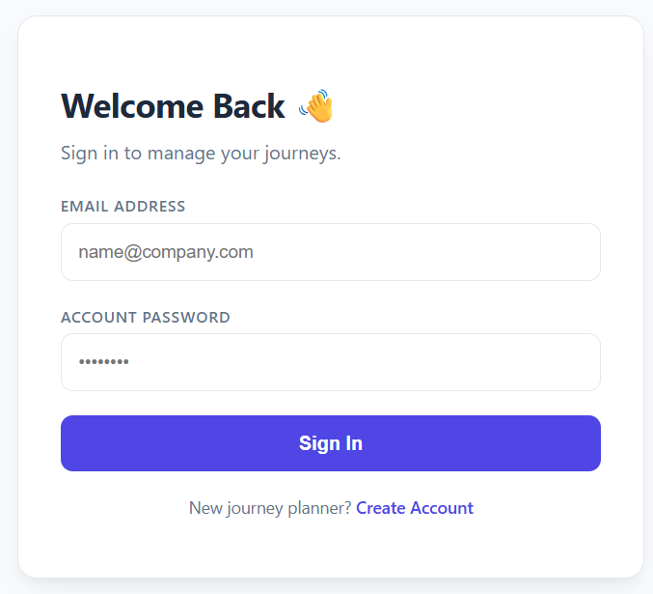
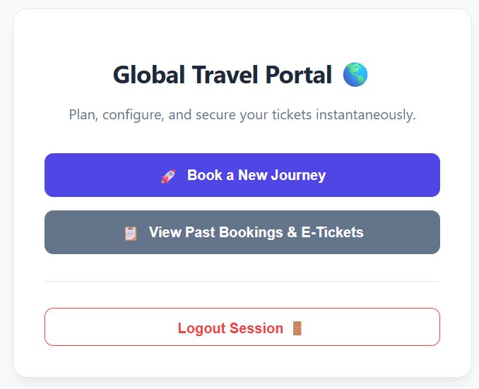
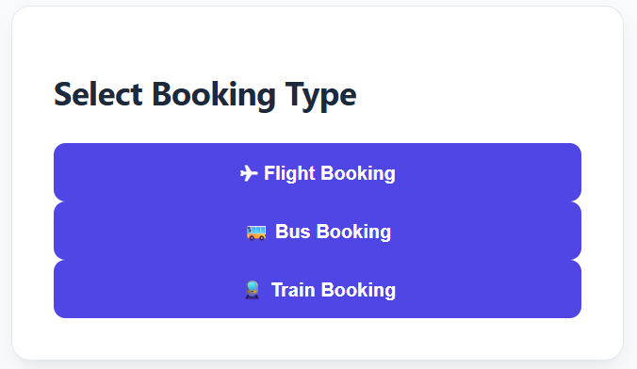
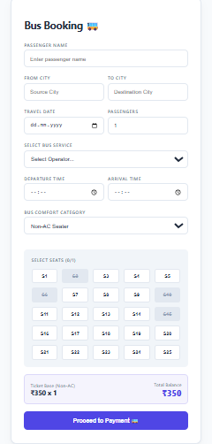
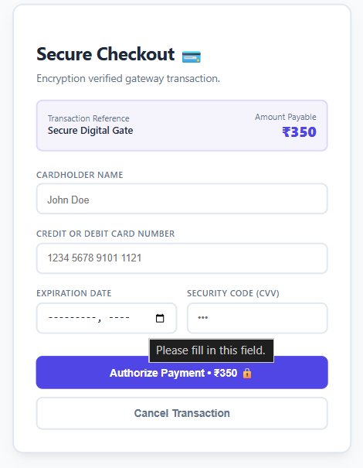
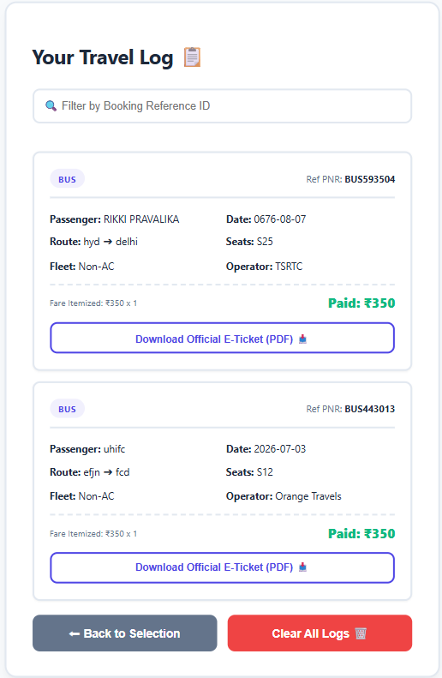
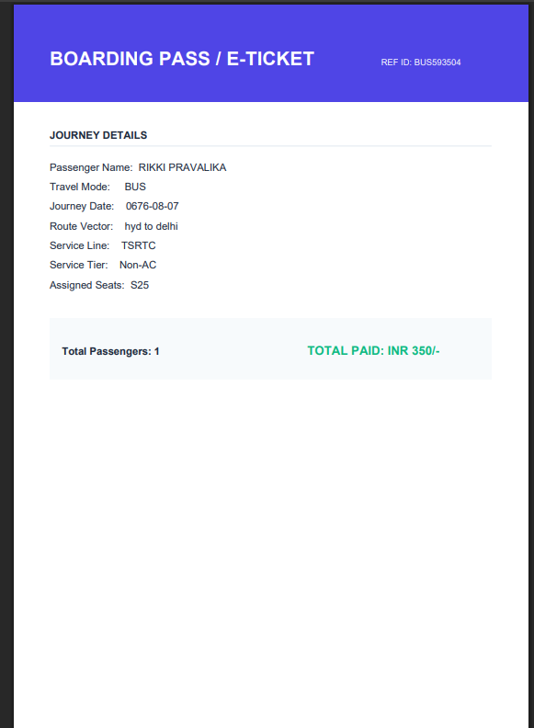

Slide 12
THANK YOU
For Your Time & Attention
Smarter Seats. Smoother Journeys.
R. Pravalika (2520030402) • Hasini (2520030086)

